Slide 1
PAPER REVIEW
ON
Arabic Language Question Answering Over Holy Qur’an Using a Post-Processed Ensemble of BERT-based Models

Slide 2
Course: Pattern Recognition (CSE424)
Semester: Fall 2022
Presented by Team 6:
ID: 17301235 - Dewan Golam Mortoza
ID: 18101502 - Sanjana Sabah Khan
ID: 16241009 - Mehreen Khan

Slide 3
Introduction:
The paper proposed solutions for OSACT5 Qur’an QA 2022 shared task. Dataset used - QRCD (The Qur’anic Reading Comprehension Dataset), a dataset for extractive question answering.
Arabic NLP research in question answering is challenging due to resource constraint as Arabic is highly inﬂectional and derivational language with complex morphological structures.
Experimenting with variety of Arabic pre-trained BERT models and implementing an ensemble approach to get robust results from a mixture of experts, MOEs.
Proposing some post-processing operations to enhance the quality of answers according to the ofﬁcial evaluation measures then evaluated as ranking task according to Partial Reciprocal Rank, pRR metric.
Related Work:
(Rajpurkar et al., 2016) introduced SQuAD1.0 dataset - widely used dataset for Q/A in English.
(Mozannar et al., 2019) automatically translated SQuAD1.0 using google translation services.
Abdelnasser et al., 2014) proposed Support Vector Machine (SVM) Q/A system with handcrafted features to extract answers from both Qur’an and its interpretation books.

Slide 4
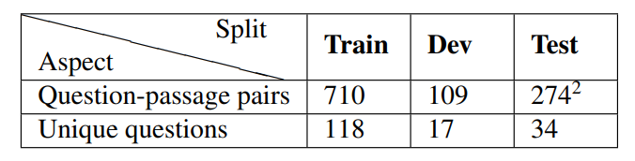
Dataset Details:
Qur’anic Reading Comprehension Dataset(QRCD) is the ﬁrst large scale Q/A dataset on Holy Qur’an consisting of 1,093 tuples of question-passage pairs coupled with their extractive answers constituting 1,337 question-passage-answer triplets and a small number of unique questions, each of which repeated multiple times with different passage and answer pairs.
The question-passage pairs are split into training, development and testing sets.
The dataset draws its inspiration from the prior work AyaTEC by reformulating the test collection into an extractive question answering task
Each sample is a question-passage-answer triplet which comprises a question in MSA, a passage taken from Holy Qur’an spans one or more consecutive verses, and an answer to the question extracted from the passage.

Slide 5
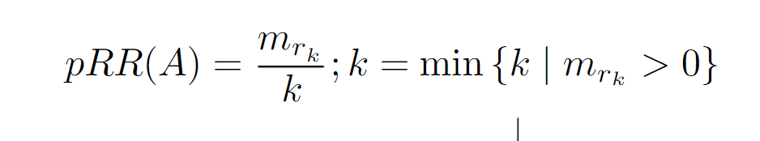
Task Description & Evaluation:
Answer exists as a span within the given passage. Solutions to the shared task are required to extract any correct answer to the input question from the context passage even when the passage has more than one answer. Questions could be either factoid or non-factoid.
QA system returns upto 5 potential answers ranked from best to worst according to probability of correctness.
The task evaluation measure produces a higher score when the correct answer is ranked at a higher position and is discounted when correct answer is predicted among 5 potential answers but is ranked lower.
The Q/A task is evaluated as a ranking task done on a scale of 5 and this task adopts the pRR.
pRR gives credit to systems that predict answers with partial inexact matching with the correct answer.
Exact Match (EM) metric, binary measure equal to one when the top predicted answer exactly matches the ground truth answer, and F1@1 metric, a measure of the degree of token overlap between the top predicted answer and any of the ground truth answers, are also used for task evaluation.
Scores computed from individual passage-question-answer triplets are averaged to compute overall score over the entire evaluation dataset.

Slide 6
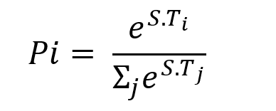
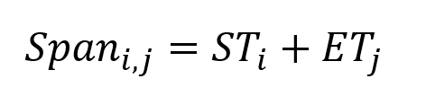
Methodology:
QA system design:
Ensemble merges predictions from five individual BERT based models pre-trained on Arabic language corpora
Models fine-tuned and a set of post-processing operations implemented
During fine-tuning, a pre-trained model is stacked with a randomly-initialized output layer suitable for particular downstream task
Both passage and question tokenized and packed into a single sequence
Output layer gives the probability such that:
A ranked list of 20 answers generated from model and ranked based on span score. Equation for the span score from i^{th} token to j^{th} token:

Slide 7
Methodology:
Arabic variants of BERT model:
arabertv02_{Large} and arabertv02_{Base} from huggingface library.
QARiB
ARBERT and MARBERT
Training Phrase:
Trained BERT-base and BERT-large models for 50 and 65 epochs respectively for obtaining the best validation split performance.
For testing phase used 32 and 40 epochs respectively.
The batch size is 8 for BERT-large and 16 for BERT-base and learning rate is 2e-5 for all models.

Slide 8
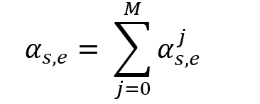
Methodology:
Span Voting Ensemble:
Ensemble approach taken to cancel noise exhibited by individual models through Mixture of Experts (MOE) technique.
For each sample, top 20 predictions made by each model along with its correctness probability.
For each candidate prediction, sum of its associated correctness probabilities from all models, α_{s,e} , are computed and the following voting process are formulated:
Set of all possible answers considered by the ensemble is sorted according to their summed ensemble correctness probabilities.
Entire ranked list is post-processed and truncated for the top 5 answers evaluated by pRR@5.

Slide 9
Methodology:
Post-processing Methods:
Handling Sub-words
Post-processing pipeline takes a ranked list of top 15 answer spans from a single model or the span-voting ensemble.
For BERT, WordPiece tokenizer used as a sub-word tokenizer.
Redundancy Elimination:
High overlapping among most of the answer spans with each other was found initially, making the ranked list suboptimal with respect to the pRR metric.
This is a common behavior for BERT QA

Slide 10
Methodology:
As pRR metric only considers (k+1)th prediction for no overlap with any of the ground-truth answer tokens for the kth prediction, repeating any of the words from the kth prediction in the (k+1)th prediction is suboptimal
Used an algorithm to ensure the ranked list after post-processing better covers the text in the passage and the pRR score increases from 0.048 to 0.769
Uninformative Answer Removal
All of the stemmed answer tokens exist in the stemmed question token
The whole answer span consists of stop-words, which can never meet the information need of a question in QRCD

Slide 11
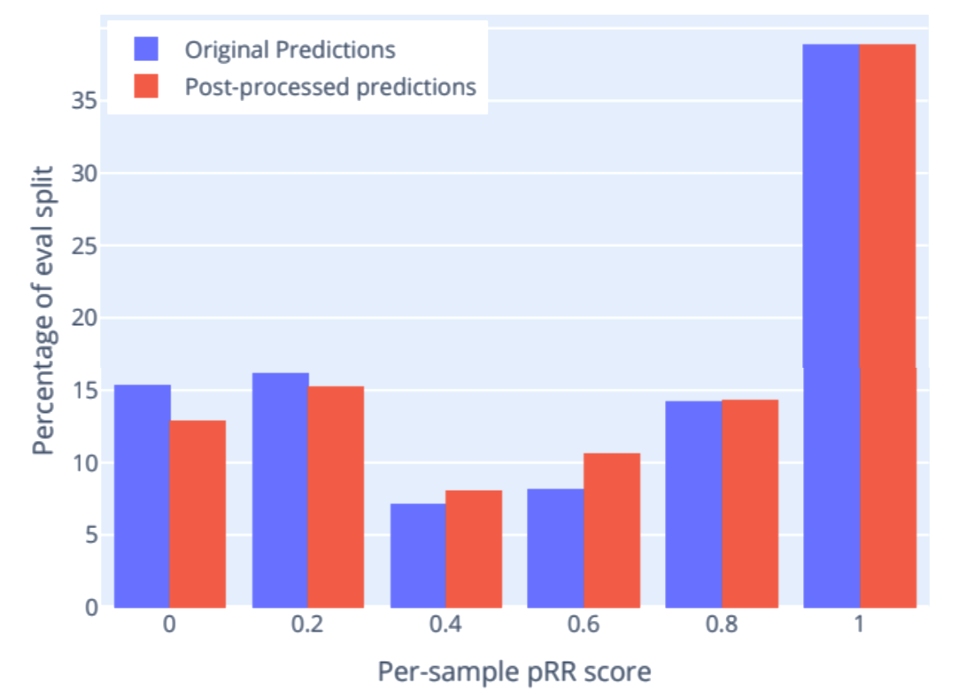
Updating Ranked List
The top 5 answer spans in the post-processed ranked list are considered for the metric evaluation (pRR@5).
The post-processing impact on the per-sample pRR score distribution.
Methodology:

Slide 12
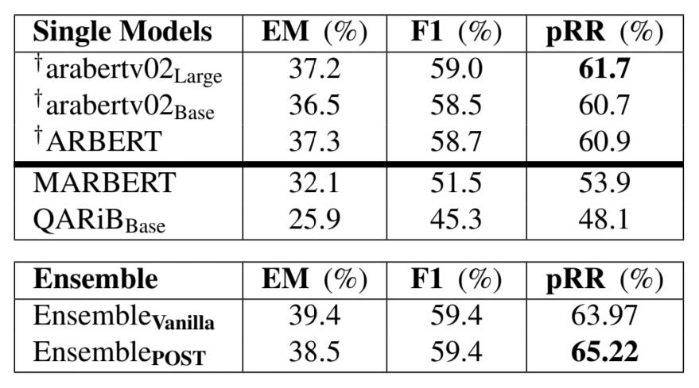
Experimental Evaluation
Development Phase
arabertv02_{Large} and arabertv02_{Base} and ARBERT are trained on training dataset.
To enable fair comparison, the reported scores are averaged for the same model trained multiple times with different seeds.
Ensemble_{Vanilla} refers to combining 45 checkpoints of models indicated by † (15 for each).
Ensemble_{POST} represents the Ensemble_{Vanilla} output after post-processing.
Table 2: QRCD development split results.

Slide 13
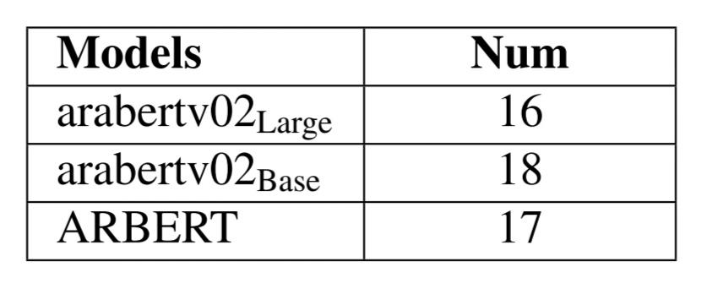
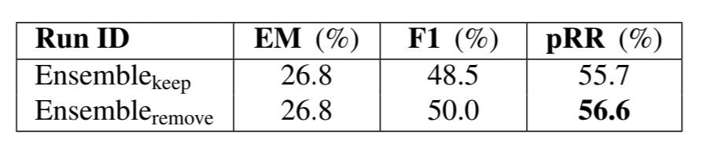
Experimental Evaluation
Competition Final Testing Phase
Each ensemble reported is a span-voting ensemble combining all models in Table 4.
Ensemble_{keep} represents the uninformative answer spans
Combining all of the models in Table 4 followed by post-processing the output predictions with uninformative span removal performs best, this is marked in the table 3 as Ensemble_{remove}.
There is a significant gap between the results in the development and test phases as in tables 2 and 3 respectively.
Table 3: Test phase official results on QRCD dataset.
Table 4: Number of models involved in the final ensemble of the test phase.

Slide 14

Conclusion
Using the post processing operations, the authors have enhanced answers aligning with the official measure.
They have stated that Ensemble based approaches are effective to produce more robust predictions.
In the future, the author wishes to -
investigate the huge variations in the reported results by performing extensive cross-validation
incorporate a stacking ensemble approach with multiple stages to achieve better performance

Slide 15
Thank You.

